Slide 1
Why Learners Make Great Open Source Contributors
Who doesn’t love to contribute?

Slide 2

Notes:
Hello everyone! I’m Yamil, a developer evangelist for sendgrid. I work on making developers life more easier by showing them how easy they can send and receive emails with sendgrid.

Slide 3

Notes:
But today I’m going to show you how I learned Go and started to give back to the community. Btw this is a gopher. And its super cool :D

Slide 4
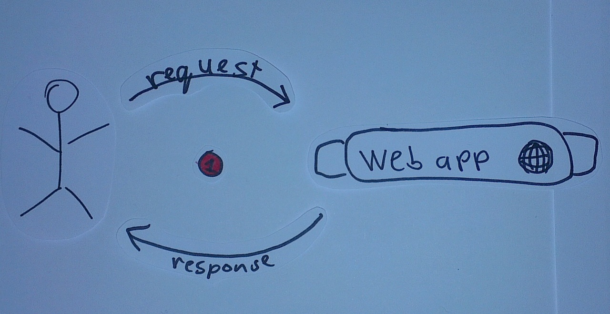
HTTP – the language of the web
Notes:
Hypertext transfer protocol or http is the language of the web. If you want to know how many twitter followers you have, you make an http request. If you want to tweet, you are making an http request. You are always doing requests! So when I learn a new language, this is the first thing I look at in the docs! How do I perform an http request ☺

Slide 5
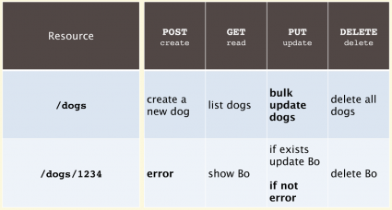
http verbs and restful api
Notes:
API’s are programable endpoints. You can define a resource and control it over http.

Slide 6

Choose your api!
Notes:
After you learn http, choose an API you want to communicate to. I normally go with an API that doesn’t have a wrapper for the language that I want to learn. Why? Cause that’s how im going to help the community. By creating somethig where is needed!

Slide 7
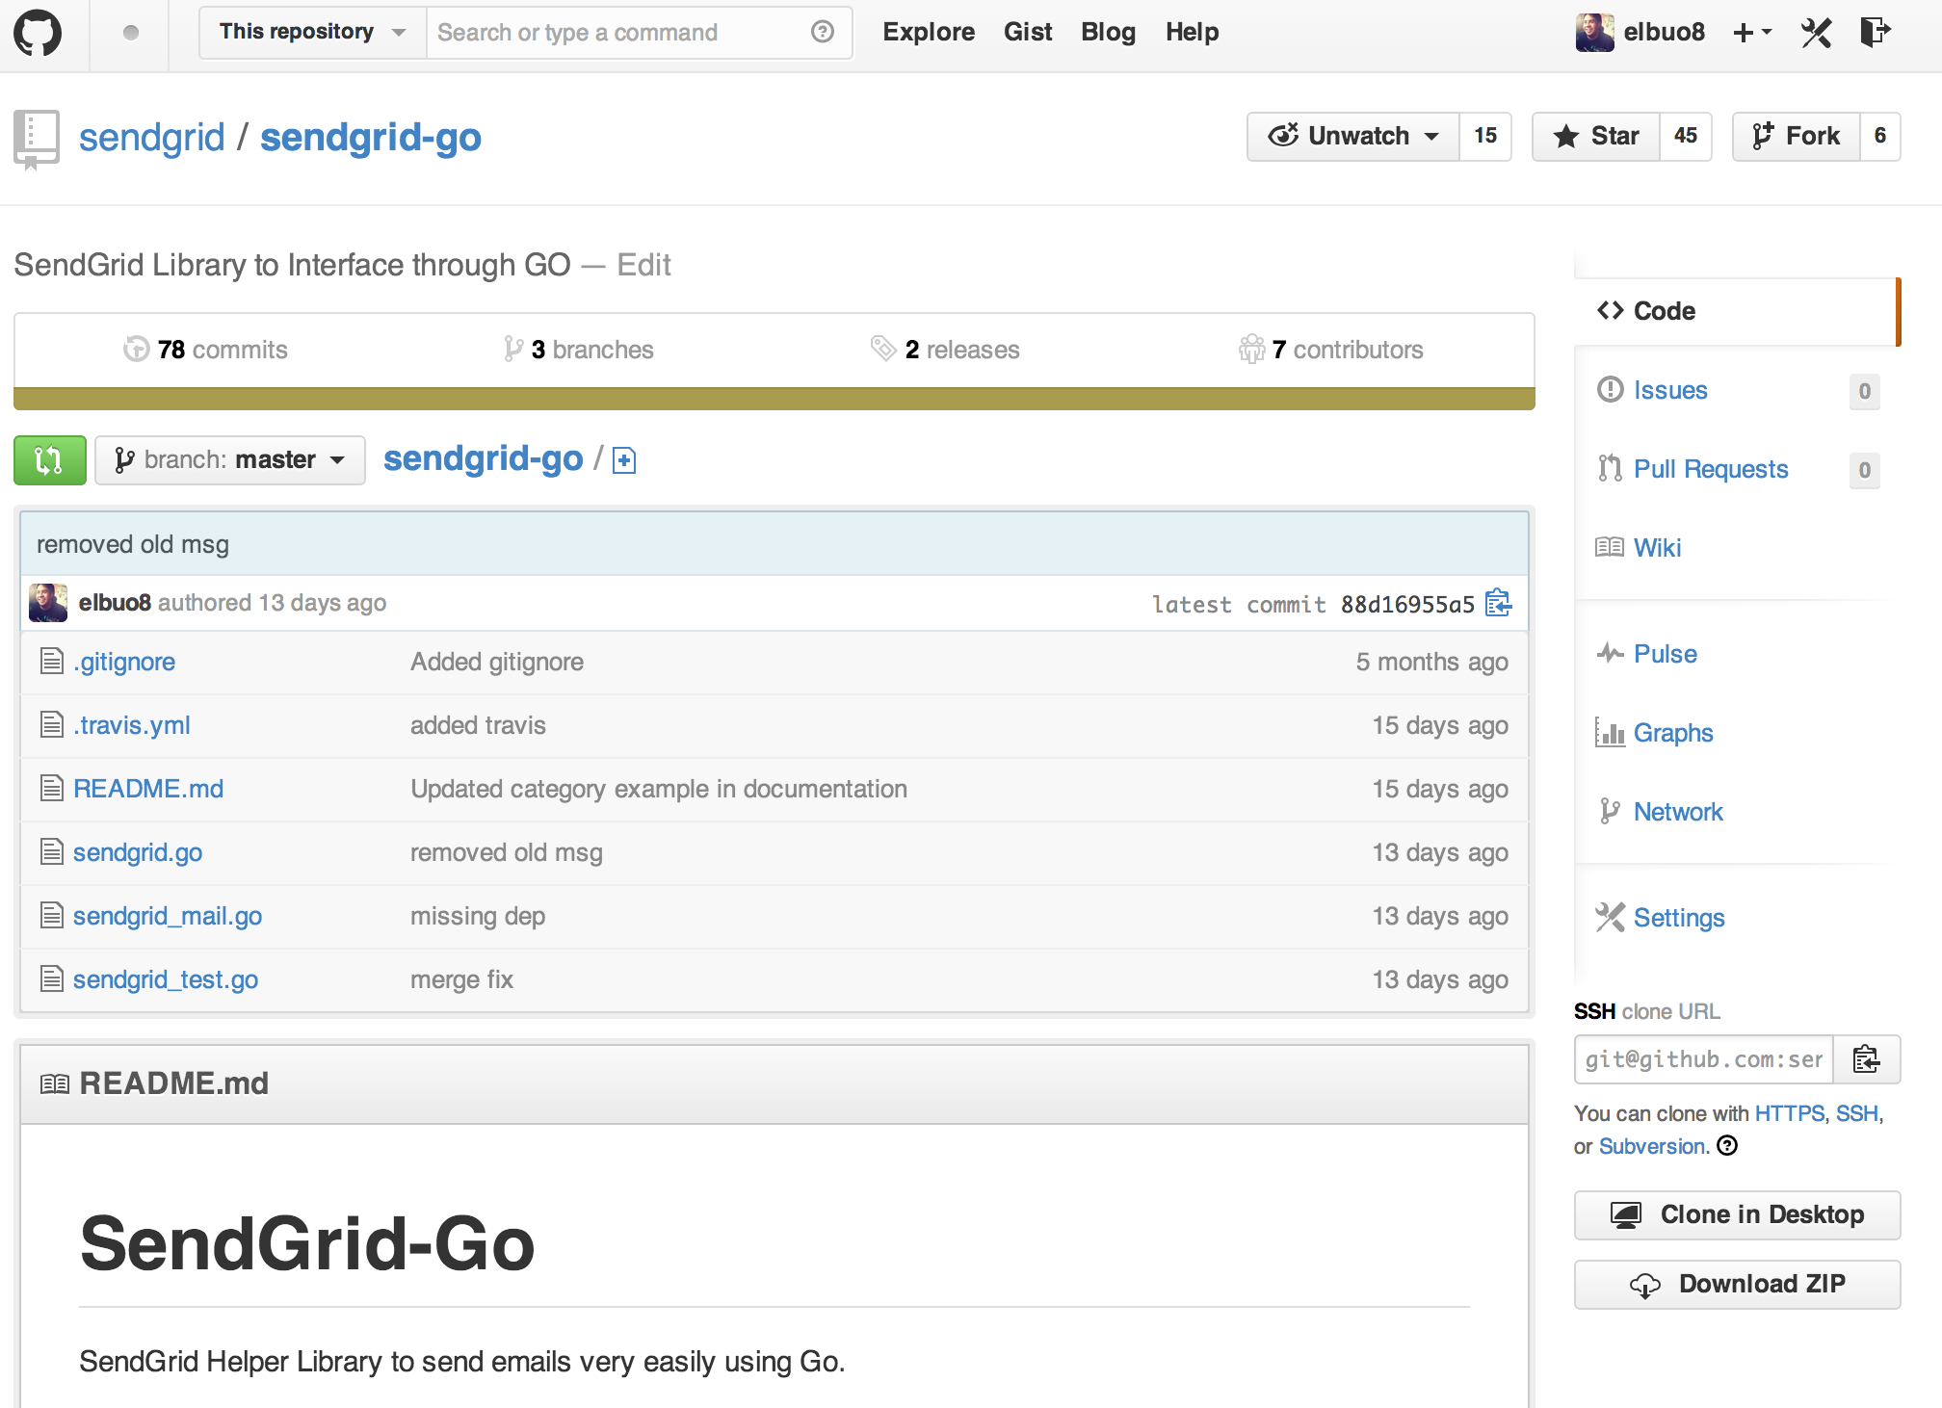
Sendgrid-go
Notes:
This was my approach. Before being an official employee I started developing the sendgrid-go wrapper. Now it it has several forks and stars. People have been making pull requests to improve on it. And I learned Go some of the basics of Go as a final result too!

